Slide 1


Project Proposal:
Microsoft Film Studio
Delivered on:
22/05/2022
Submitted by:
Patriciah Nici Mboya

Slide 2
Table of Contents
01.Project Context and objectives
02.tools used
03.DATA ANALYSIS
04.RECOMMENDATIONS
05.CONCLUSIONS

Slide 3

01.PROJECT CONTEXT AND OBJECTIVES
Table of content

Slide 4
Project Context and Objectives
Project Context.
Microsoft sees all the big companies creating original video content and they want to get in on the fun.
Project Objectives
Exploring what types of films are currently doing the best at the box office
Translating those findings into actionable insights that the head of Microsoft's new movie studio can use to help decide what type of films to create.

Slide 5

02.TOOLS USED
TABLE OF CONTENT
This Photo by Unknown author is licensed under CC BY-SA-NC.

Slide 6
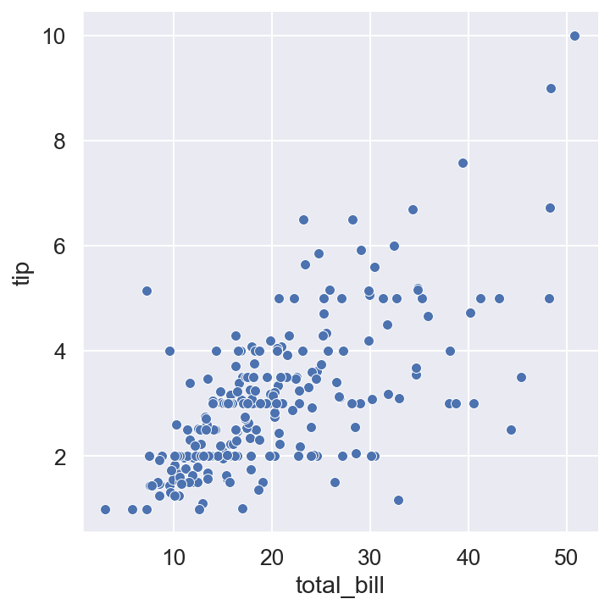
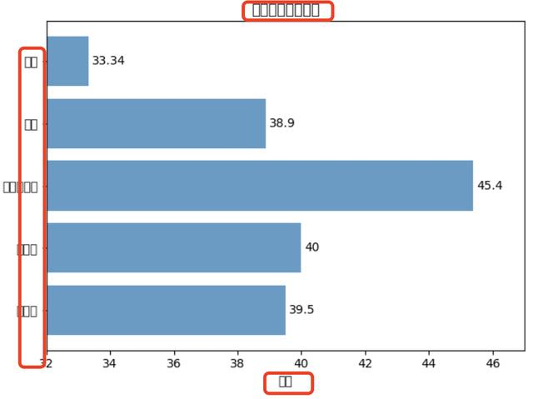

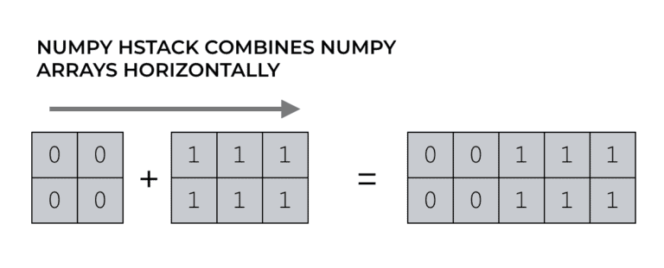
Tool Used For Project Development
Some of the libraries imported to help in the project development are pandas, numpy,seaborn and matplotlib
This Photo by Unknown author is licensed under CC BY-SA.
.

Slide 7

TABLE OF CONTENT
03.DATA ANALYSIS

Slide 8
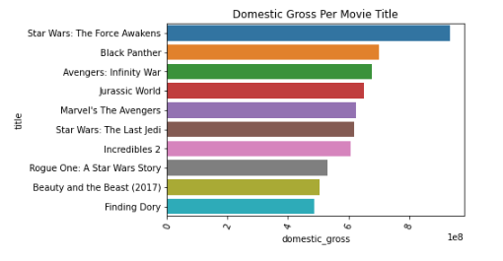
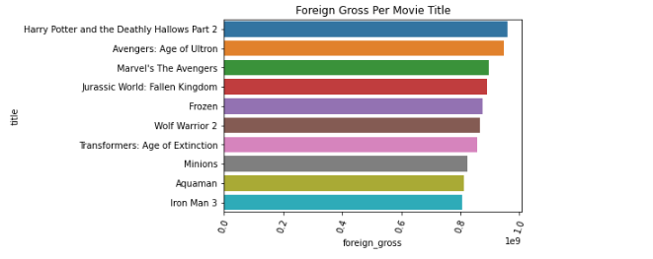
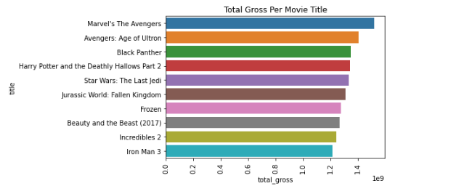
DATA ANALYSIS
Domestic Gross
Foreign Gross
Total Gross
10 Movie titles that realized the highest domestic gross
10 Movie titles that realized the highest foreign gross
10 Movie titles that realized the highest total gross income

Slide 9
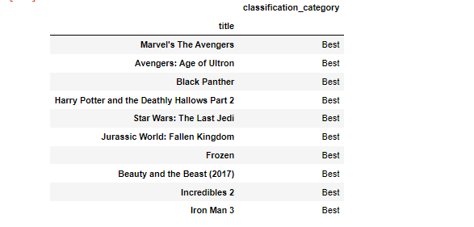
DATA ANALYSIS
Best movie titles
here we classified movie titles with respect to the total gross
.The 10 best movie titles wrt total gross are shown on the left

Slide 10
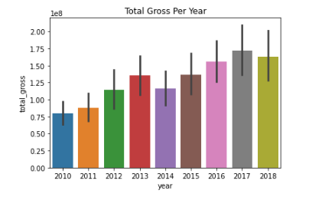
DATA ANALYSIS
Visualization of year(total gross)
The barplot on the left shows the total gross realized in each year.
We can also see that the year 2017 realized the highest total gross
While the year 2010 realized the lowest total gross and that released the highest total gross after creating movie titles.

Slide 11
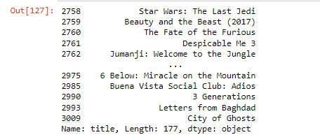
DATA ANALYSIS
Movie Titles Released in 2017
Since the year 2017 realized the highest total gross, I saw it best to list the movie titles that were created in this year. The movie titles are shown on the left

Slide 12
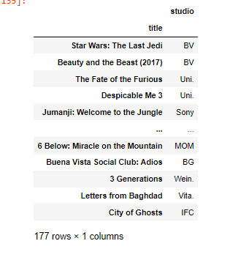
DATA ANALYSIS
Studios that created the movie titles in 2017
We have seen the movie titles that were created in 2017,the year that realized the highest total gross.
I thought it would be best to find out which studios developed these film titles, which are listed on the left.

Slide 13
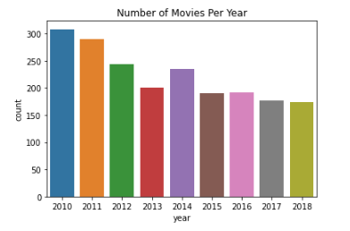
DATA ANALYSIS
Number of Movies created Per Year
From the bar plot on the left we can actually see how many movie titles were created each year from the year 2010 to 2018.
The year 2010 had the most number of movies
While the year 2017 that realized the highest total gross had the lowest number of movie titles released

Slide 14
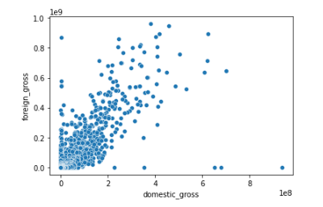
DATA ANALYSIS
COMPARISON BETWEEN DOMESTIC GROSS AND FOREIGN GROSS
Here we see how the domestic gross compares to the foreign gross and we see that they are positively correlated

Slide 15

04.RECOMMENDATIONS
TABLE OF CONTENT

Slide 16
RECOMMENDATIONS
As a Data Scientist these are my insights based on Microsoft's Business Question
1.If Microsoft studio is targeting the International market-which will bring in more foreign gross: The head of Microsoft's new studio should consider the top 10 Movie Titles that brought in more foreign gross income. The top 10 movie titles are as shown above.
If Microsoft studio is targeting the local market-which will bring in more domestic gross: The head of Microsoft's new studio should consider the top 10 Movie Titles that brought in more domestic gross income. The top 10 movie titles are as shown above.
If Microsoft studio is targeting both the International and local markets-which will bring in more foreign and domestic gross: The head of Microsoft's new studio should consider the top 10 Movie Titles that brought in more total gross income
2..There are 502 movie titles that are currently doing excellently/best at the market. But among these also the top tire (top 10) are also listed and therefore the head of Microsoft's new movie studio has the option of the best 10 of the top category

Slide 17
RECOMMENDATIONS
5.The year 2017 realized the highest total gross. For Microsoft new movie studio to realize a similar or higher total gross i recommend creating the same films that were created in the year 2017.The list is provided above
I also recommend Microsoft's new movie studio head to visit the studios that produced the top movies produced in 2017 to benchmark and see how the movies were created. The list of the studios and the respective movie titles are shown above
The number of movie titles produced every year has been decreasing save for 2014.I recommend Microsoft new movie studio to produce movie titles just as was produced in 2017 to realize an equal or higher total gross income as was in 2017
9.Creating Movie Titles that can be watched both locally and internationally is of the best interest to Microsoft new studio since an increase in domestic gross results in an increase in foreign gross as shown above. The new Microsoft studio would appreciate a good return in total gross, am I right?

Slide 18

05.CONCLUSION
TABLE OF CONTENT
This Photo by Unknown author is licensed under CC BY-SA.

Slide 19

SUMMARY:
Microsoft's best interest should be in creating movie titles that can be seen both locally and worldwide, because of the positive correlation between domestic gross and foreign gross
2017 was the year with the highest total gross. I recommend making the same films that were made in 2017 for Microsoft's new movie studio to achieve a similar or higher overall gross.
I also advise Microsoft's new movie studio chief to pay a visit to the studios that produced the year's best films in order to benchmark and observe how they were made. The studios and their respective film titles are listed above.

Slide 20

This Photo by Unknown author is licensed under CC BY.

